Slide 1

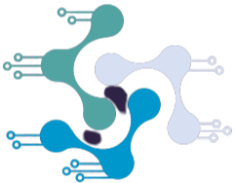
Inter IIT Tech Meet 10.0
DRDO’s UAV Guided UGV Navigation Challenge
Team 14

Slide 2
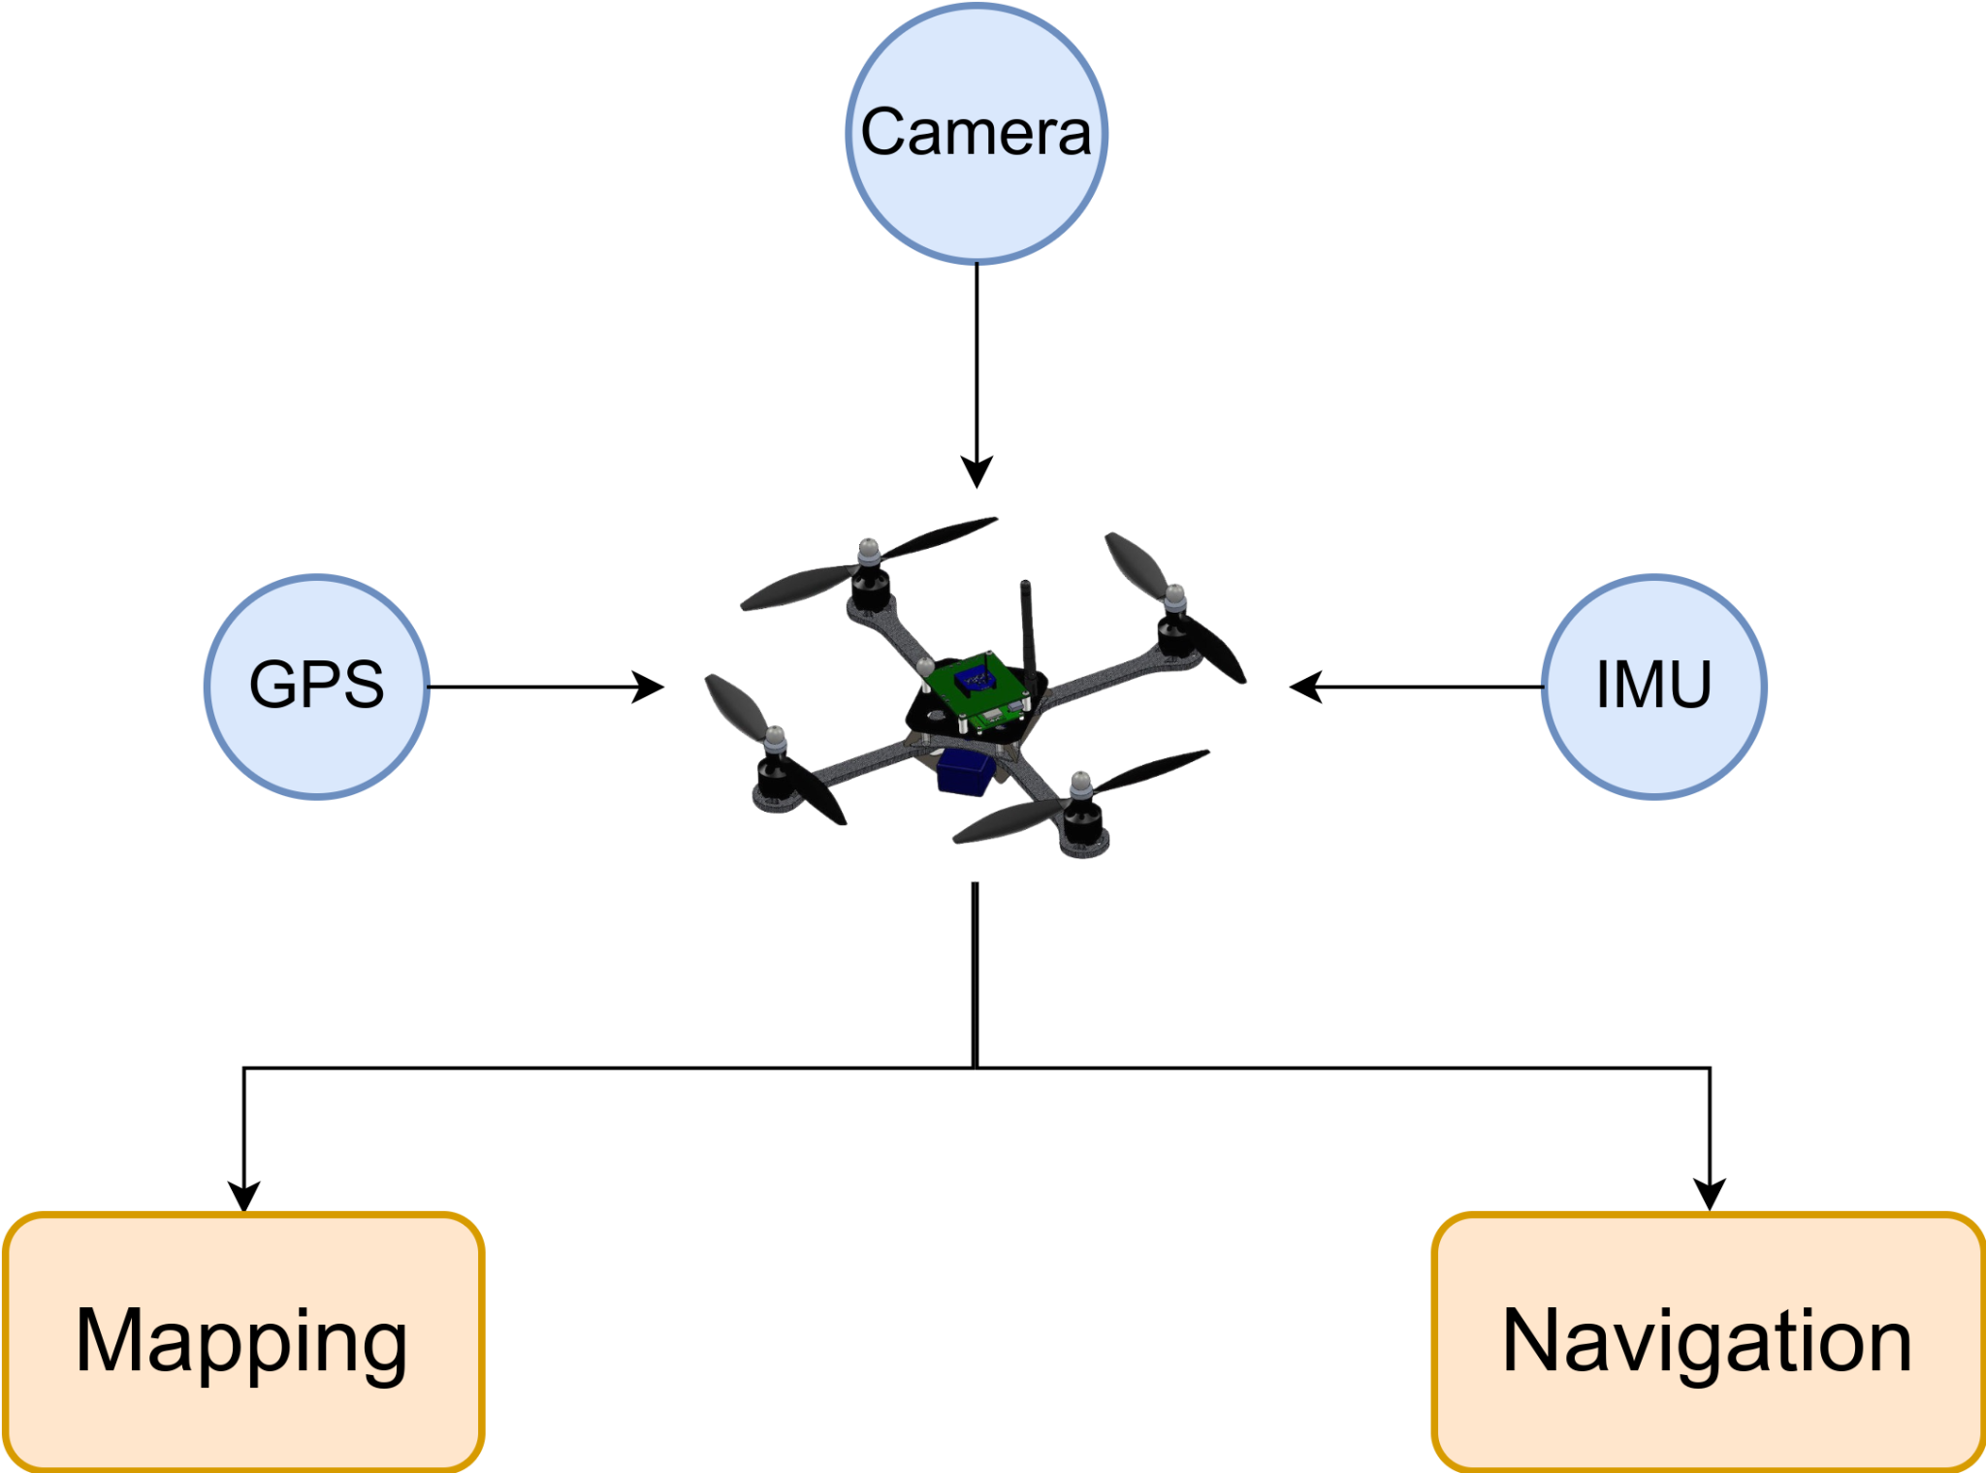
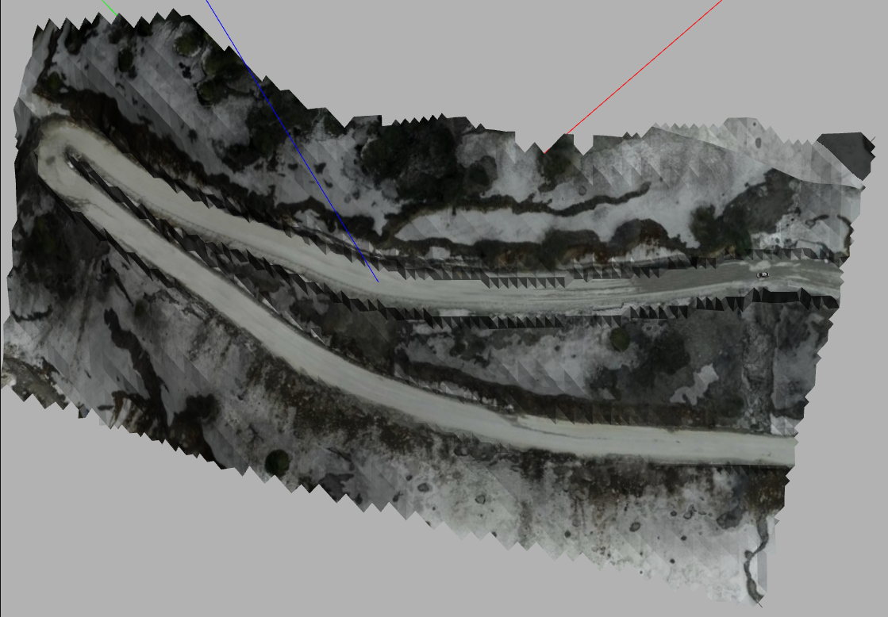
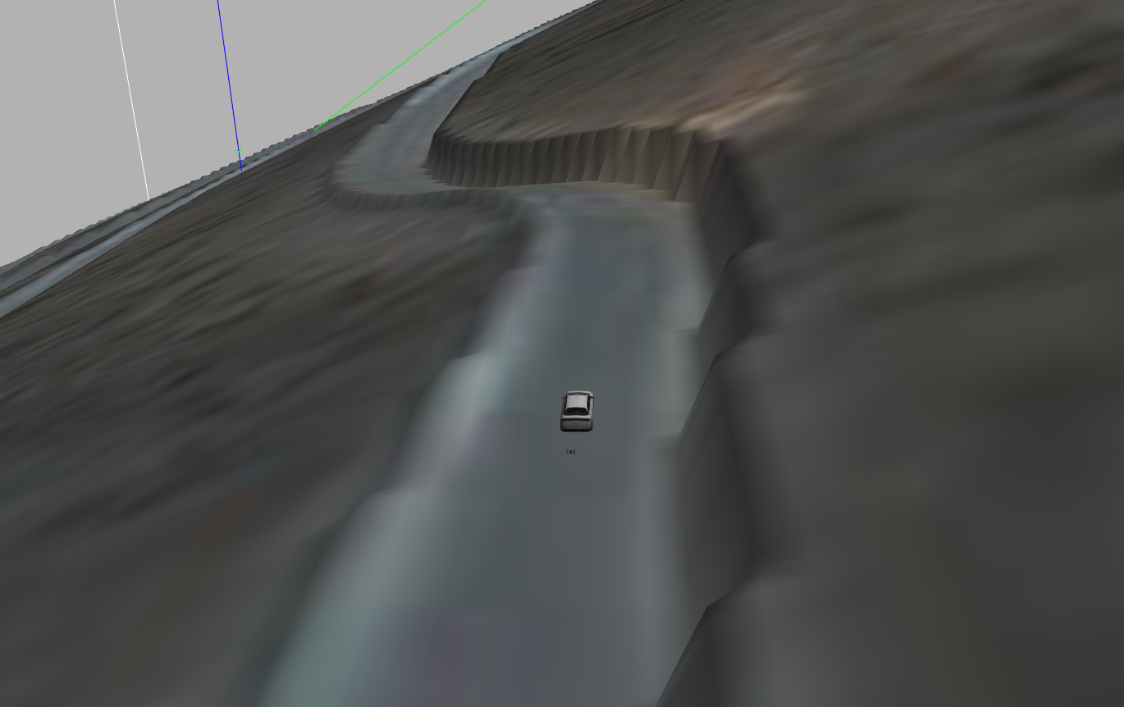
Task

Slide 3
Phase - I : Mapping

Slide 4
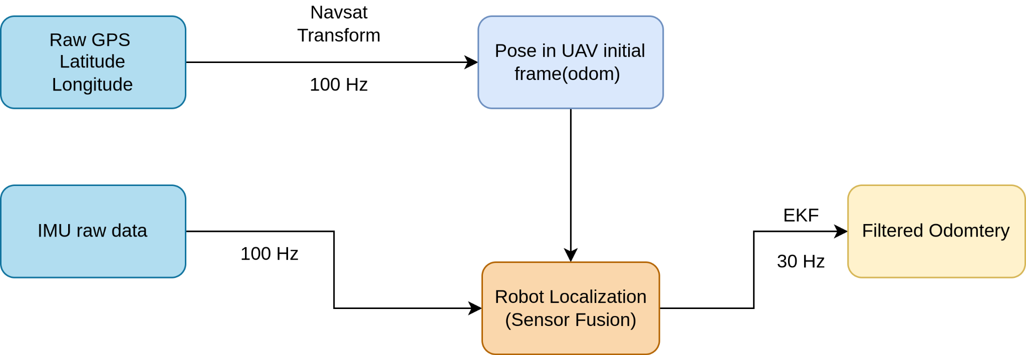
UAV Localization

Slide 5
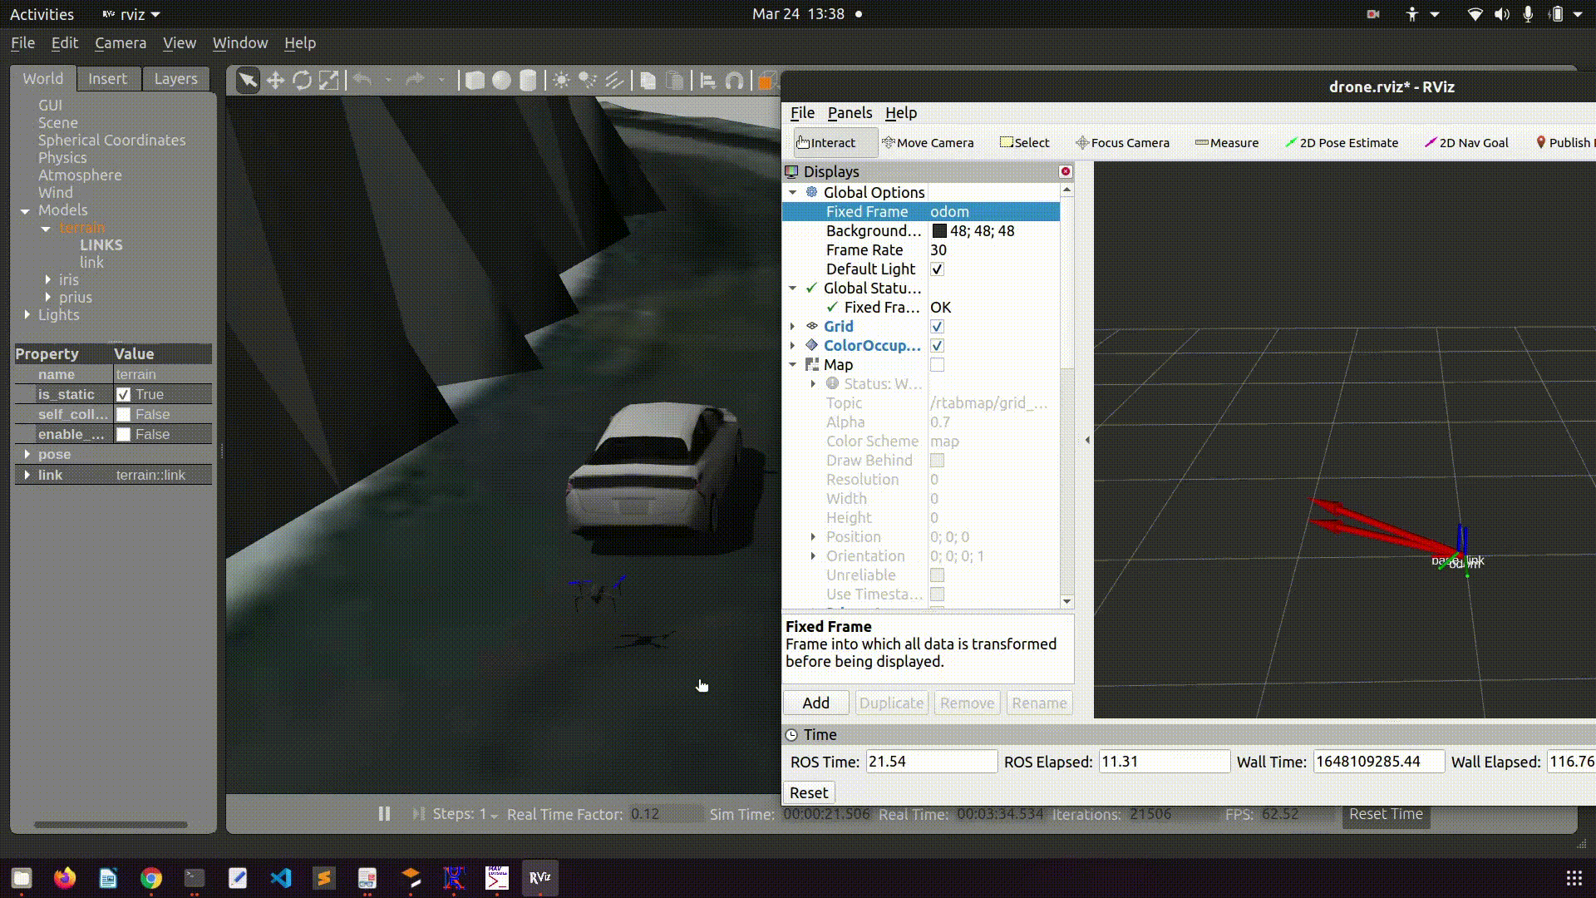
UAV Localization

Slide 6
Accuracy Report
Maximum observed error after multiple-goal points turned out to be ±0.5 meters in all three axes
Calculated the error by transforming the actual location of the UAV as reported by Gazebo to the initial start position of the drone that is the Odom frame.

Slide 7
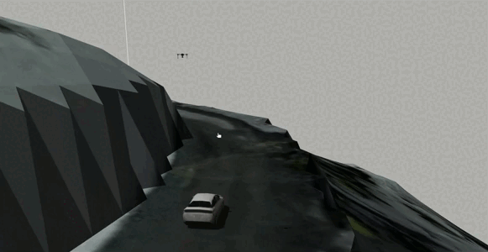
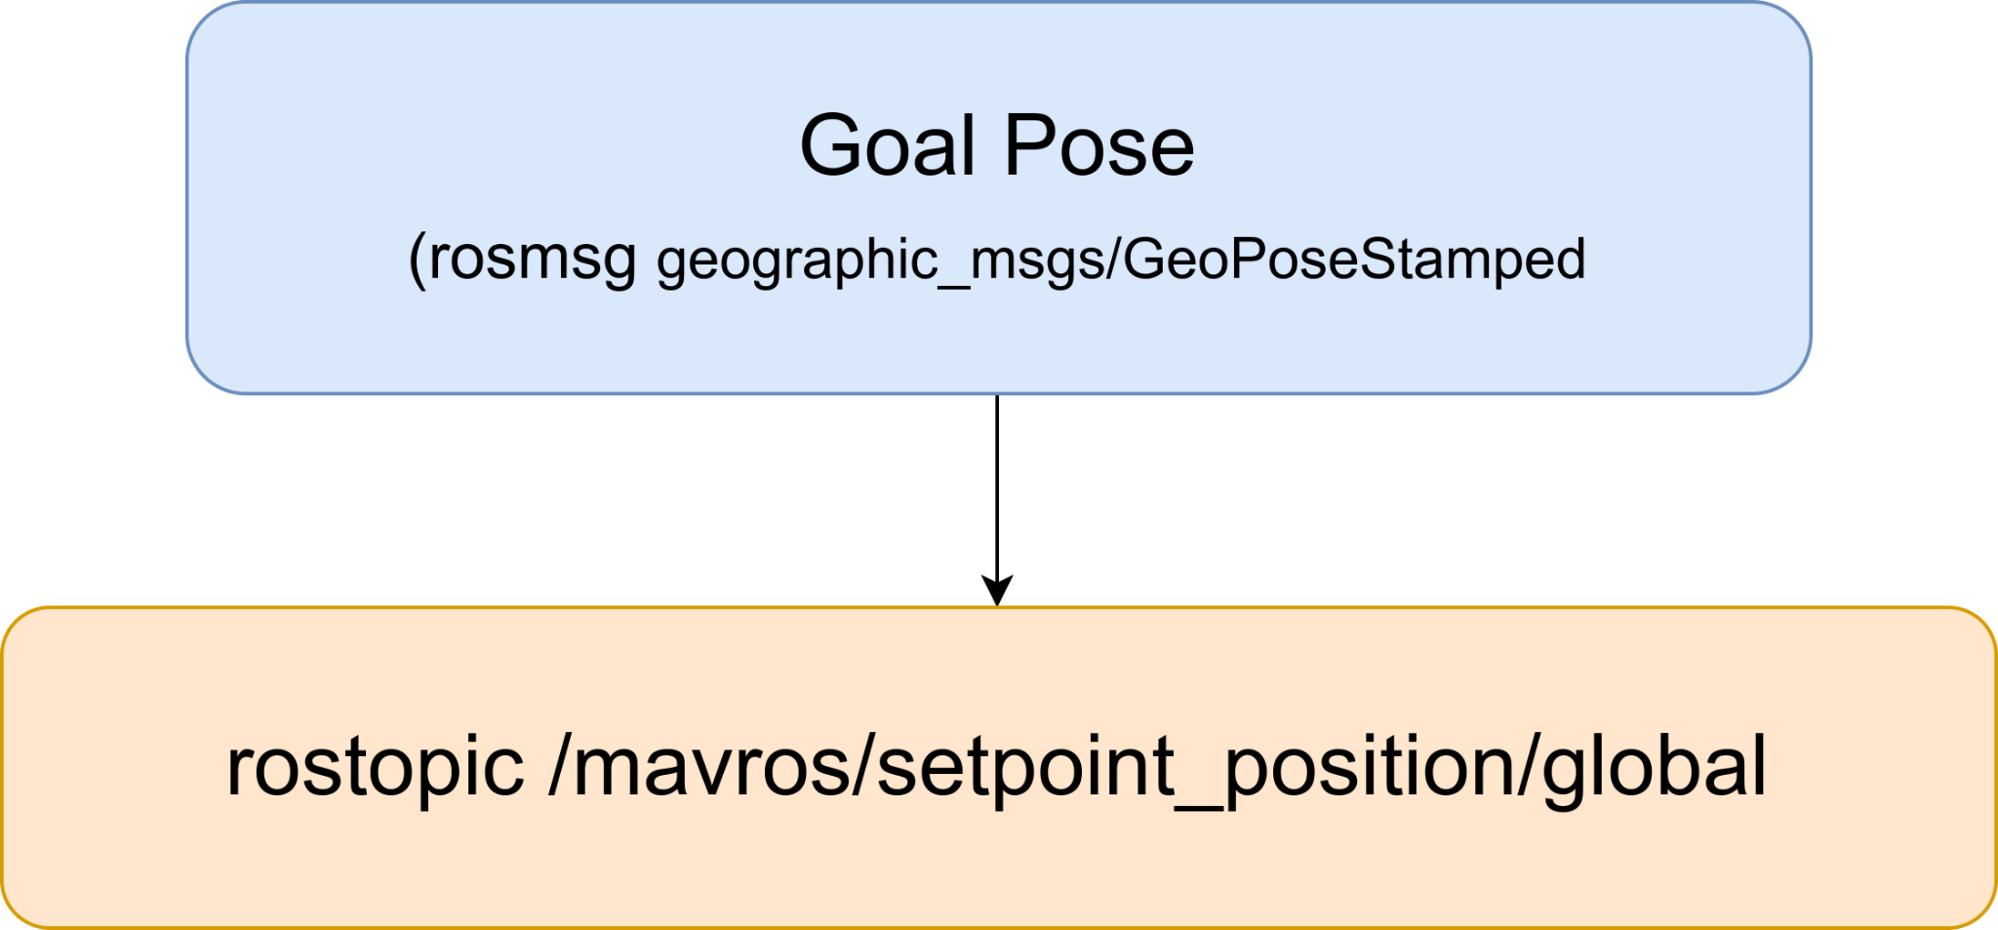
UAV Control

Slide 8
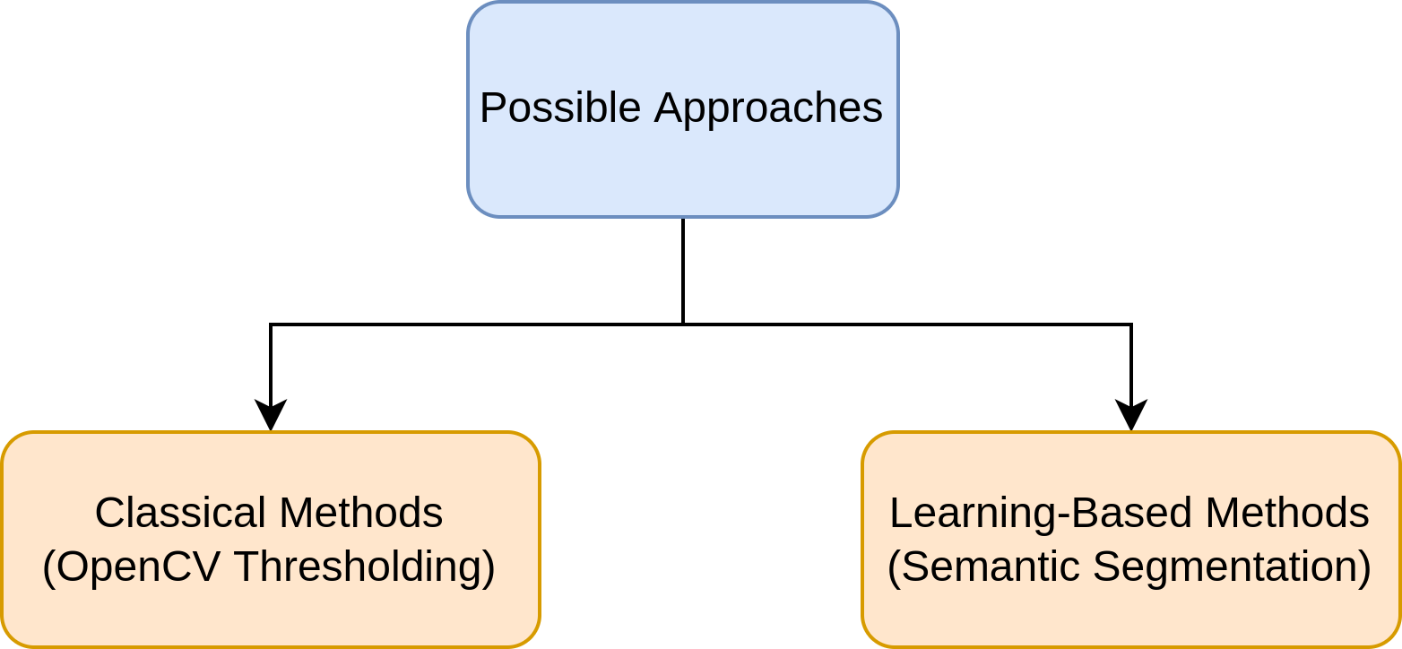
Road Segmentation : Approach Selection

Slide 9
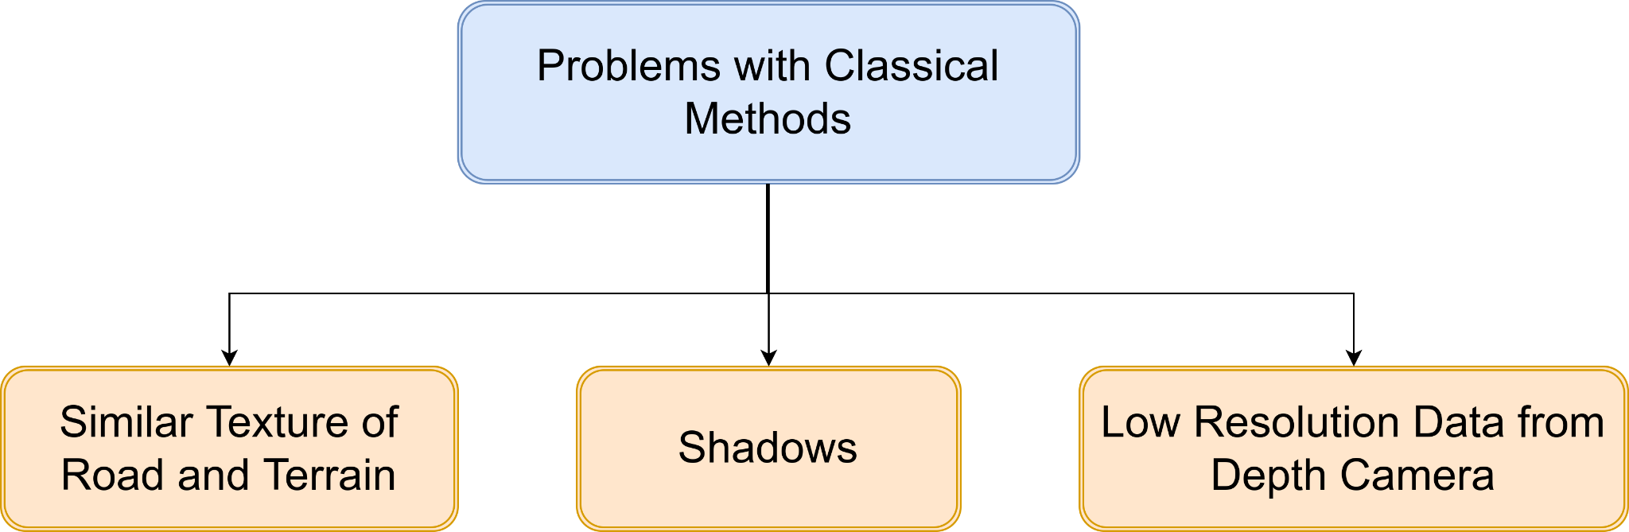
Road Segmentation : Approach Selection

Slide 10
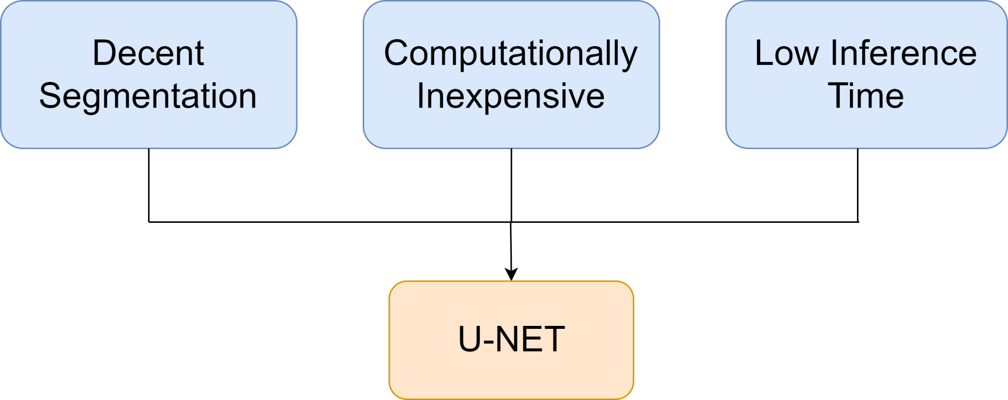
Semantic Segmentation : Model Selection

Slide 11
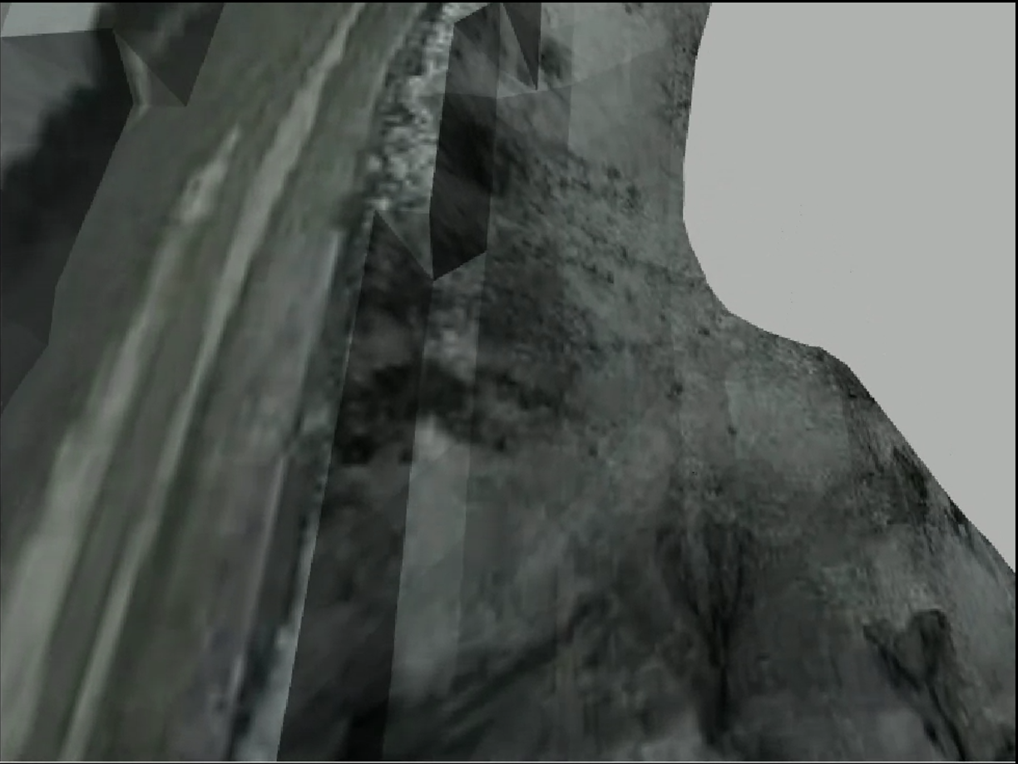
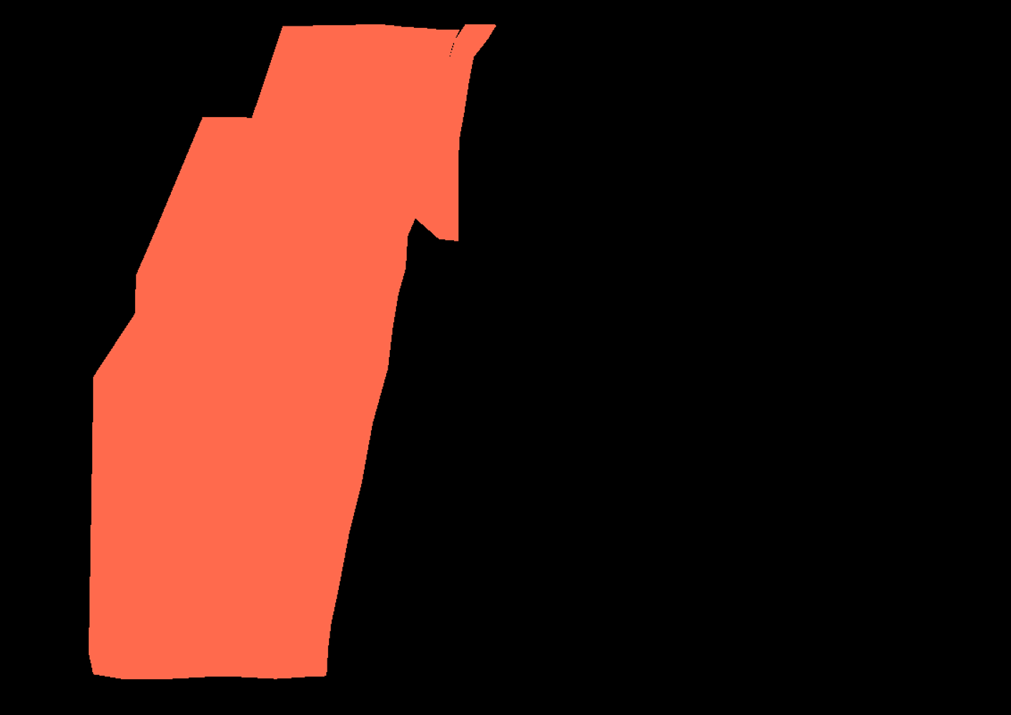
Dataset Generation and Annotation
Image from Gazebo world captured by the UAV
Annotated using the CVAT online tool

Slide 12
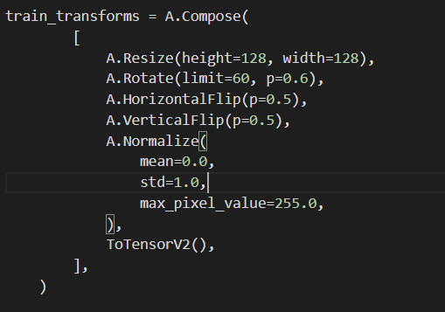
Augmenting the Data
Need for augmentation:
Only 95 images as training data.
Augmentation generates more Data.
Augmentations used :
Rotation with limit 60 degrees and probability 0.6
Horizontal Flip with probability 0.5
Vertical Flip with probability 0.5

Slide 13
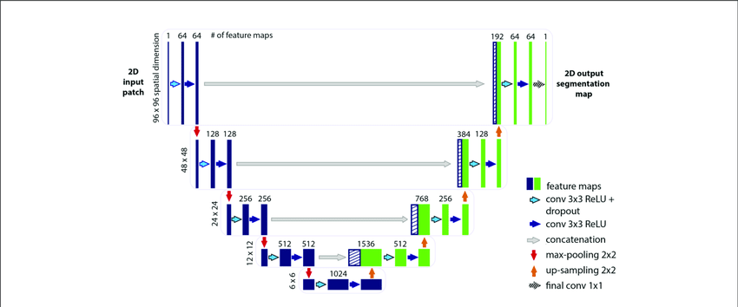
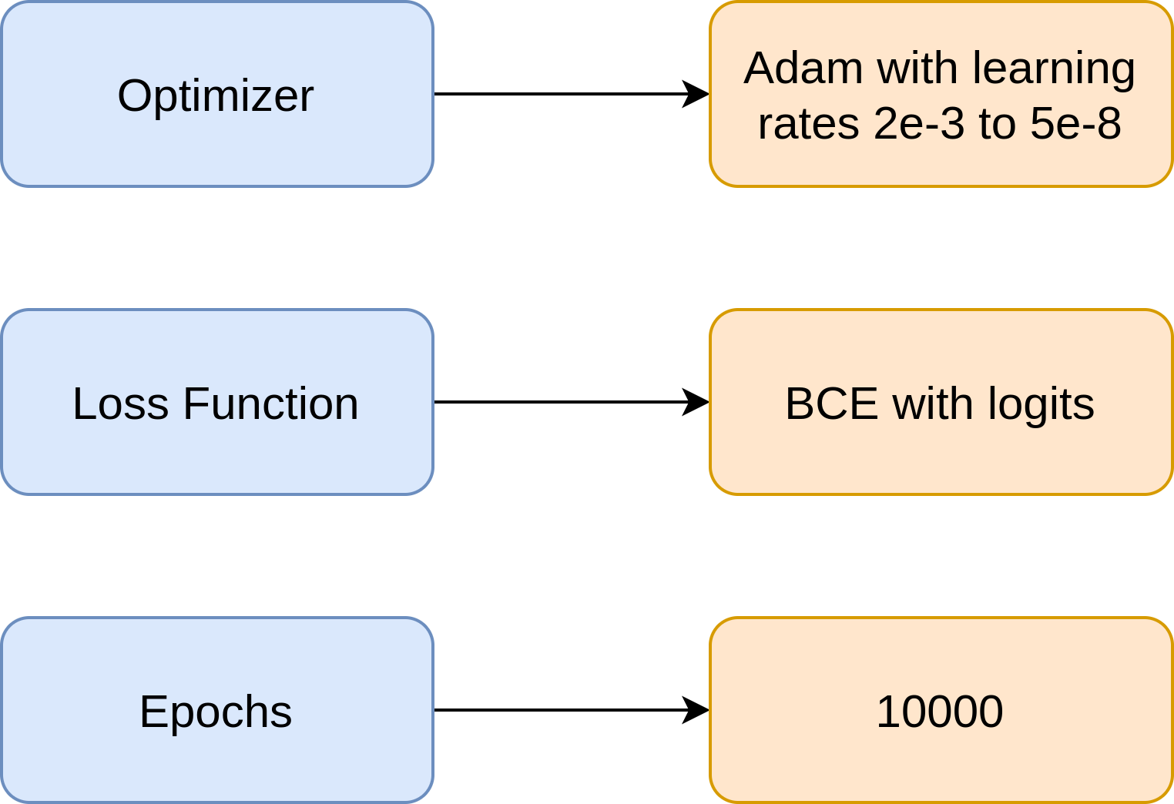
Training U-Net

Slide 14
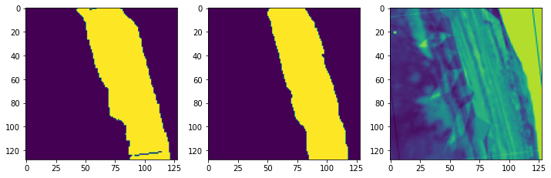
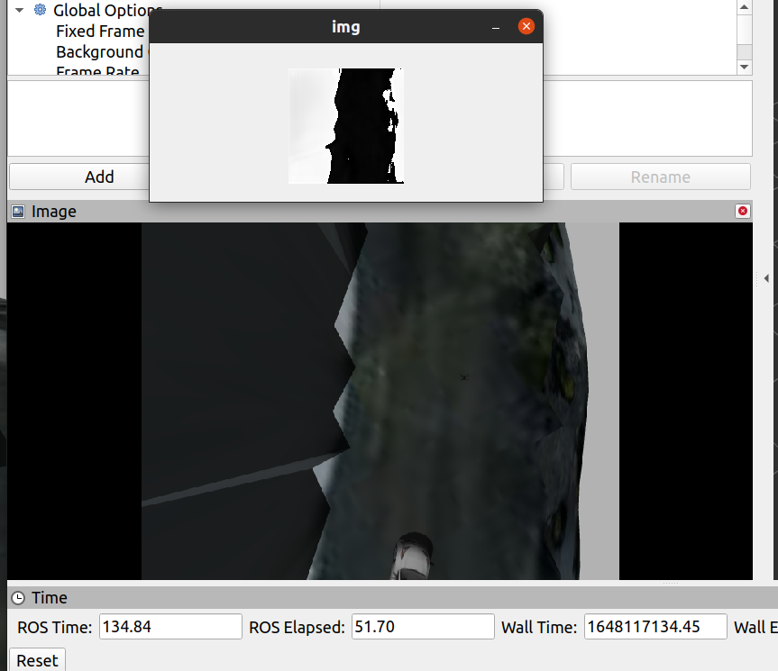
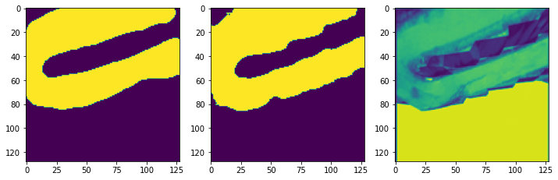
Road Segmentation Results
Accuracy on Test Data - 96.4% Inference time = 170ms

Slide 15
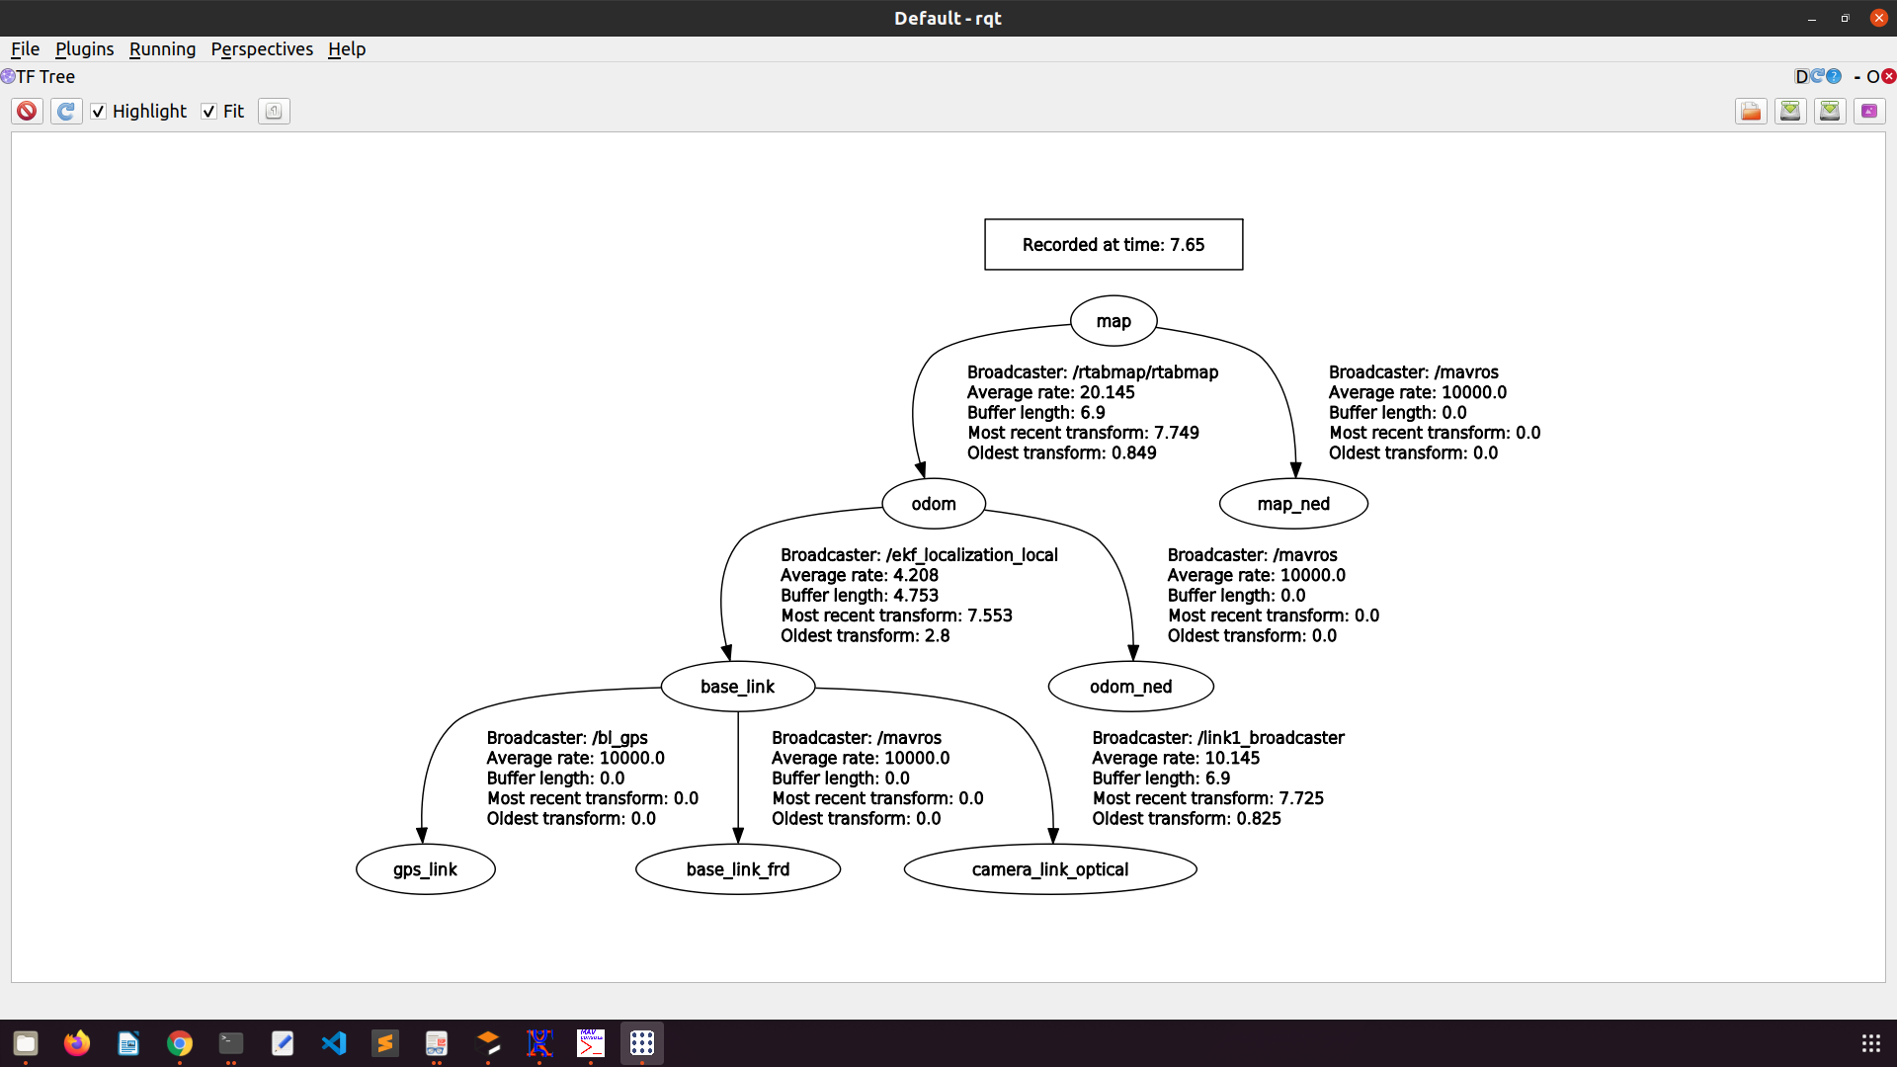
Fixes In TF Tree
Static_transform_publisher between the base_link and camera_link_optical with a
transformation of (0 0.01 -0.07 1.57 3.14 0)

Slide 16
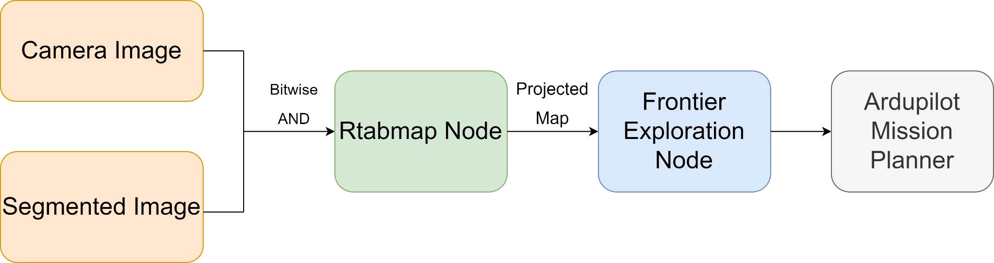
Mapping and Exploration

Slide 17
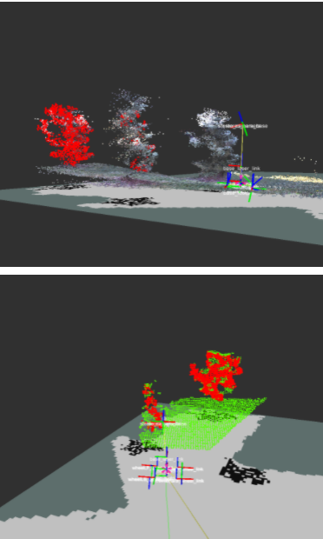
Mapping and Exploration
RTAB-Map
(Real-Time Appearance-Based Mapping)
RTAB-Map is a RGB-D SLAM approach based on an incremental appearance-based loop closure detector.
The algorithm uses data collected from vision sensors to localize the robot and map the environment.
A process called loop closures is used to determine whether the robot has seen a location before. As the robot travels to new areas in its environment, the map is expanded.

Slide 18
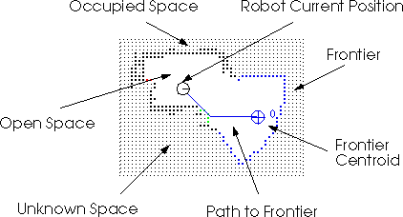
Mapping and Exploration
Frontier Exploration
Frontiers are regions on the boundary between open space and unexplored space.
.
The approach involves navigating towards these frontiers and building the map.
By moving to a new frontier, we can keep building the map of the environment, until there are no new frontiers left to detect.

Slide 19
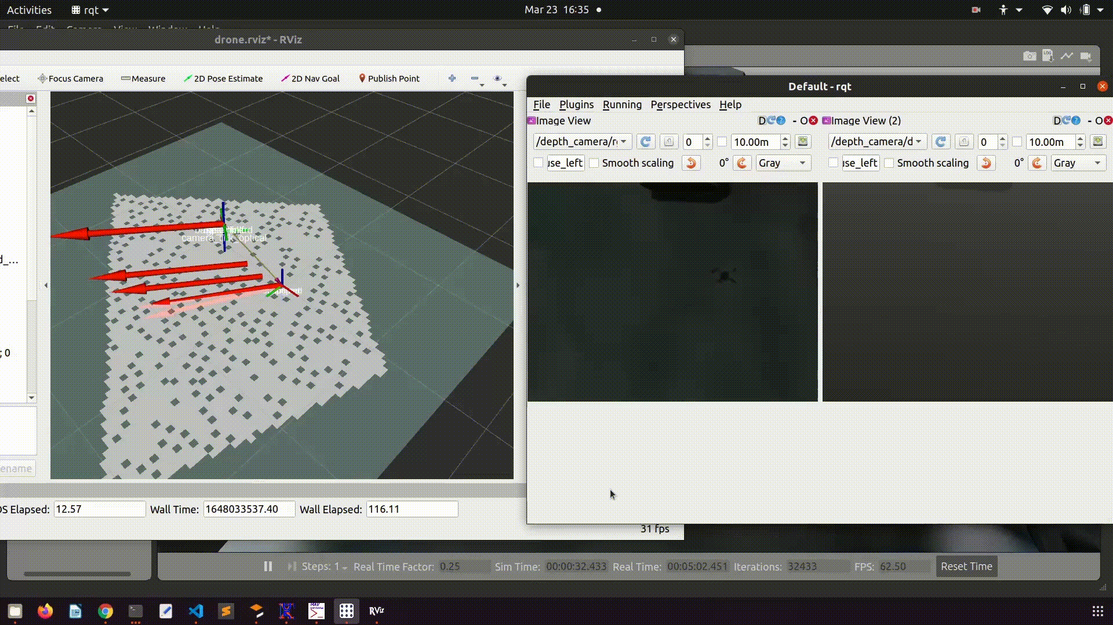
Mapping and Exploration

Slide 20
Phase - II : Navigation

Slide 21
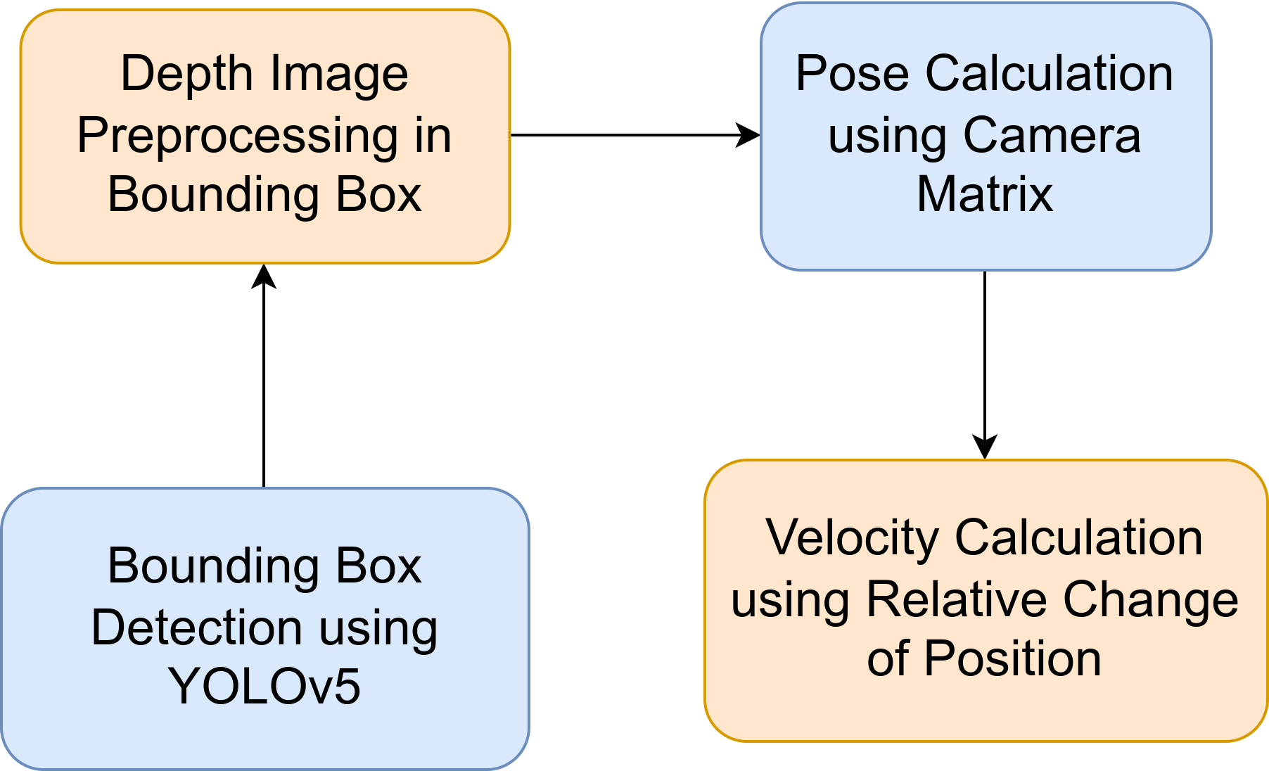
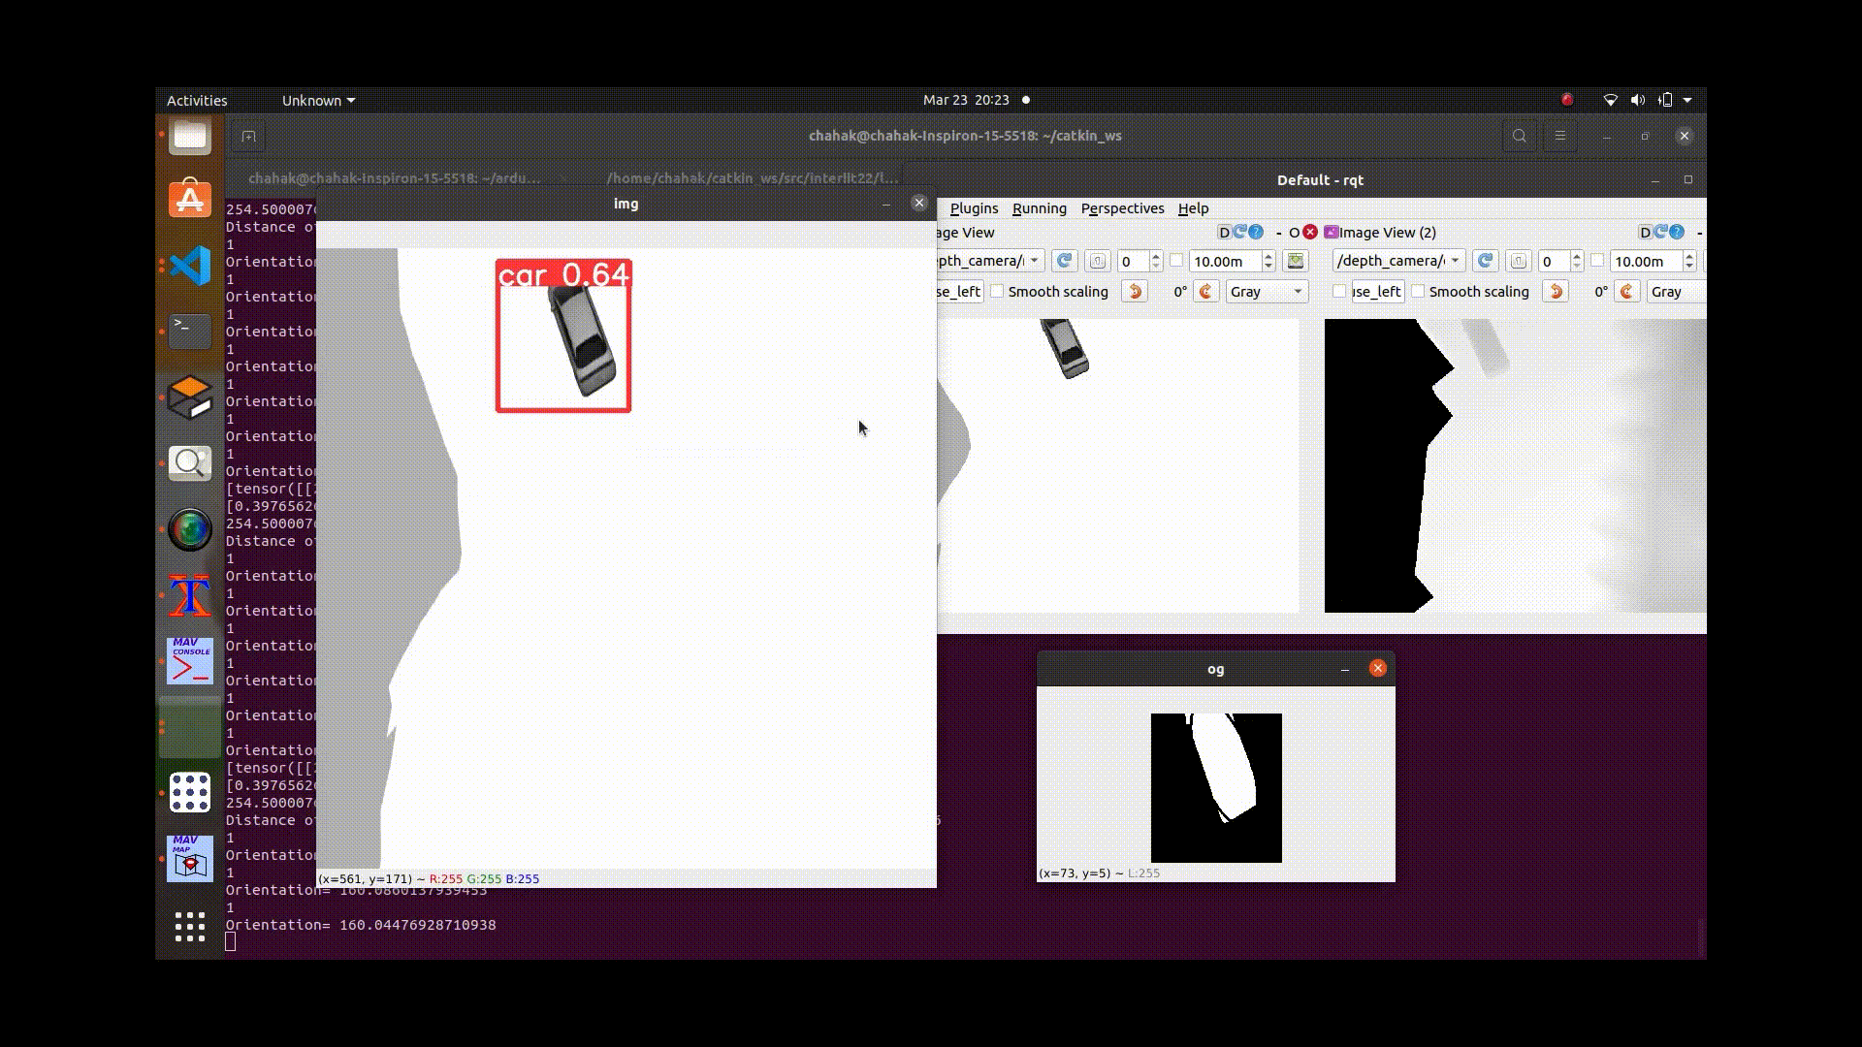
UGV Detection and Tracking : Approach

Slide 22
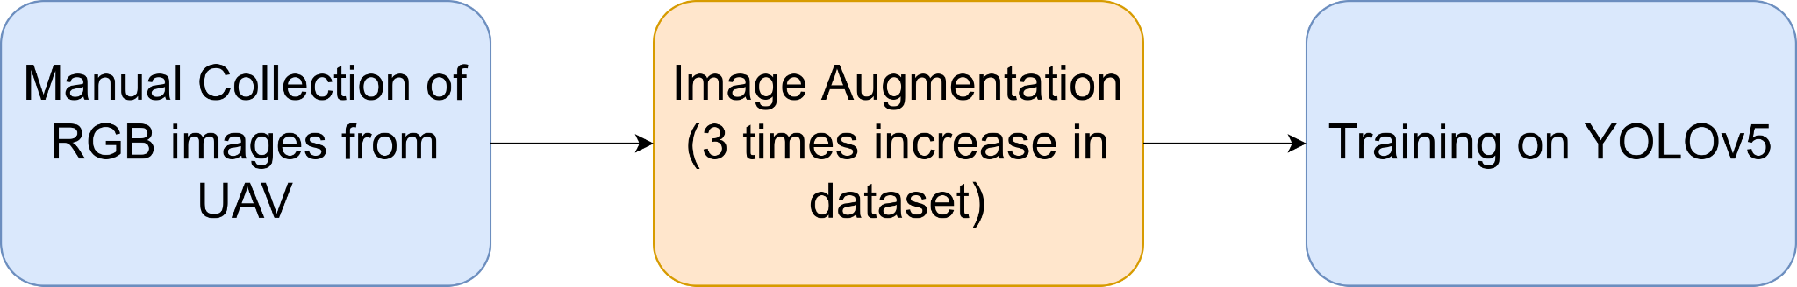
UGV Detection using YOLOv5
RESULTS :
mAP@0.5 scores: 0.989
mAP@0.5.:95 scores: 0.552

Slide 23
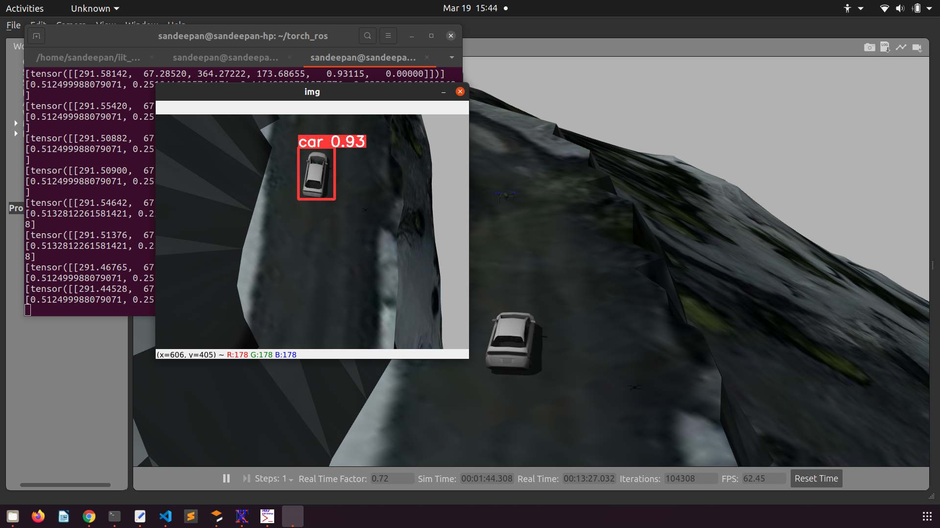
Yolov5 Detection

Slide 24
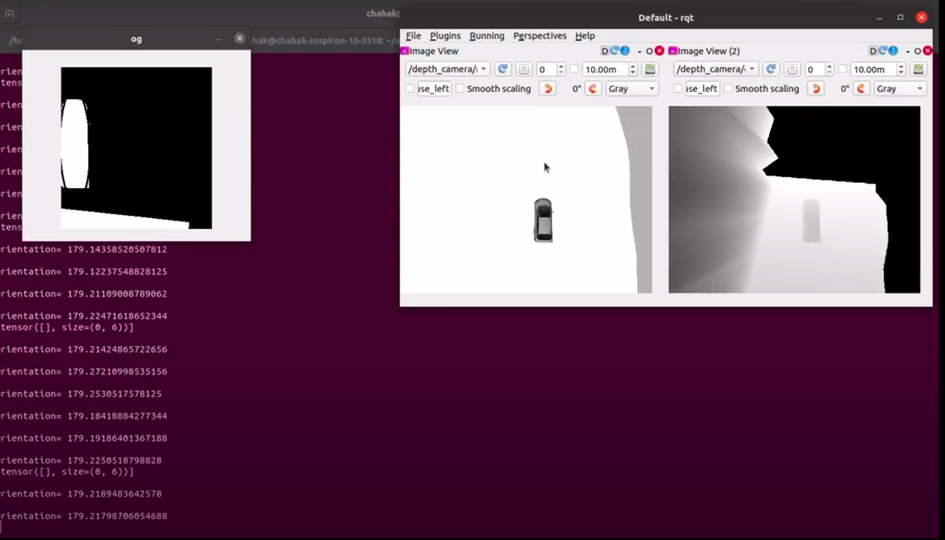
Orientation from Depth Image
Orientation 179° as determined from Depth Image

Slide 25
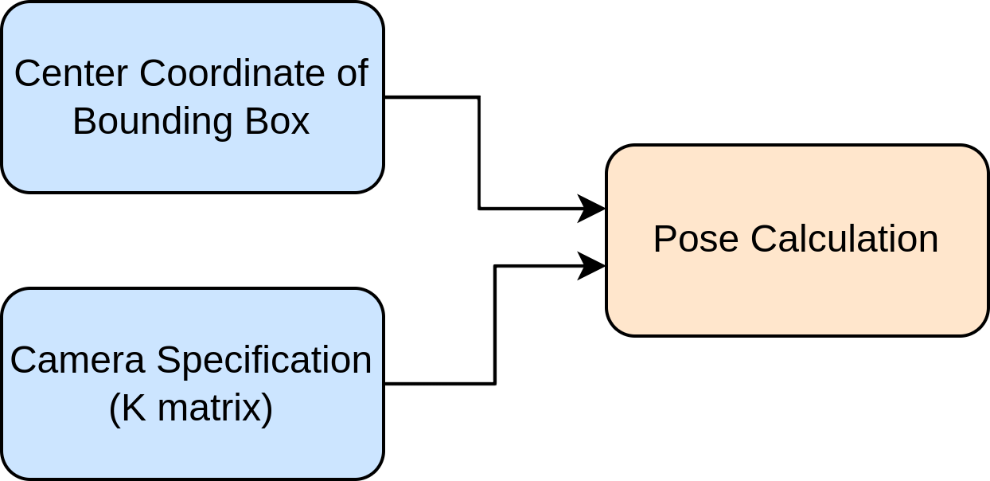
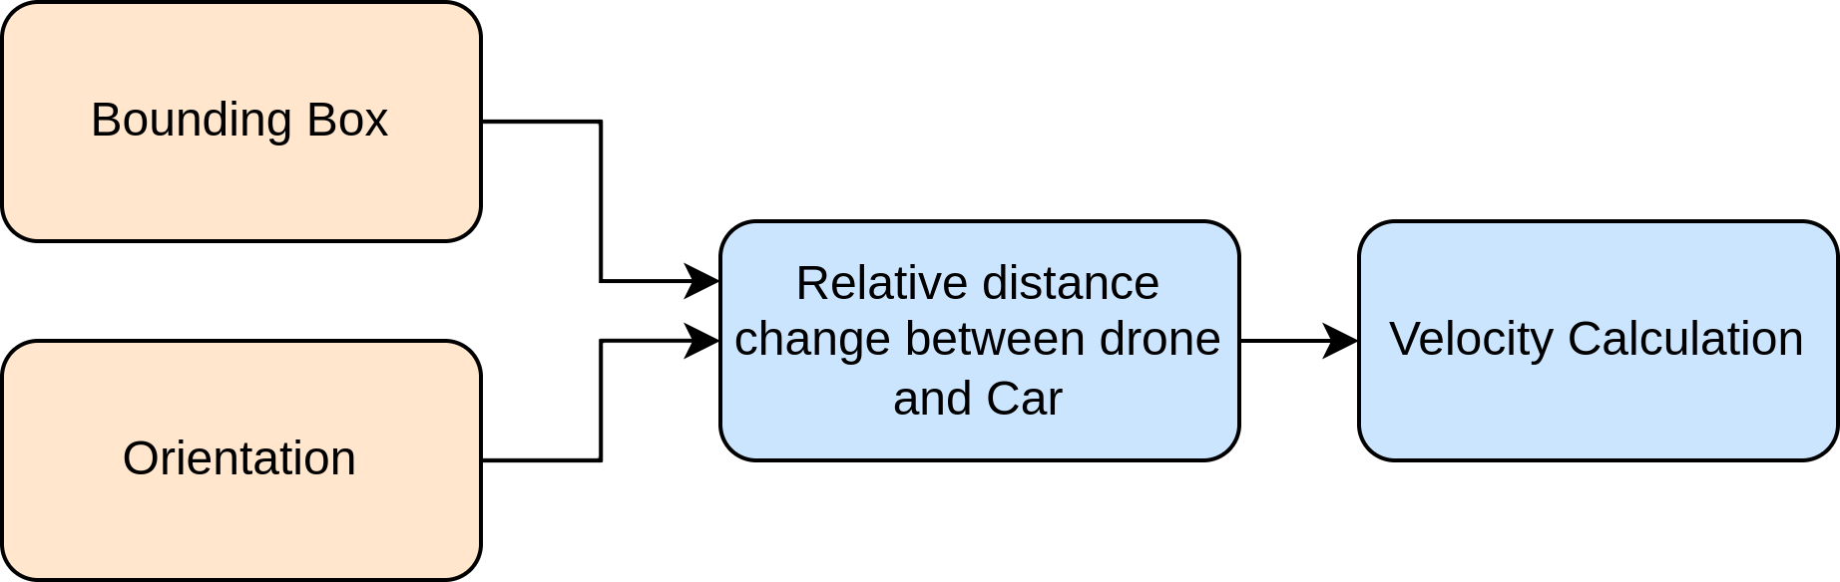
UGV Tracking

Slide 26
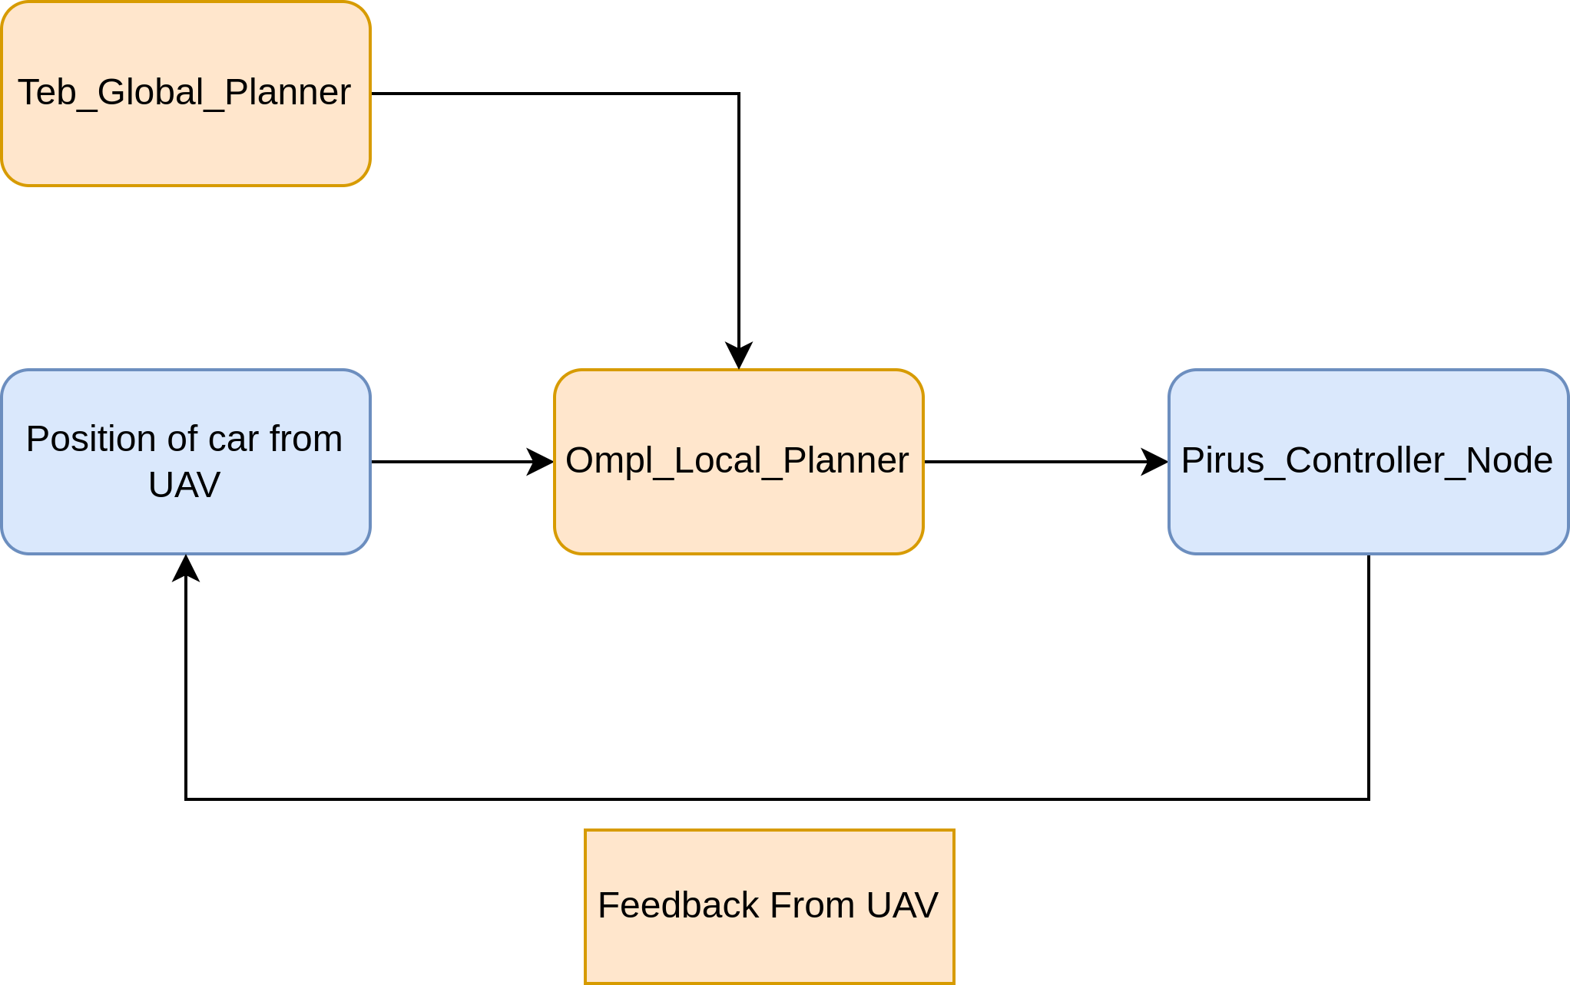
UGV Controls
(A* Based)

Slide 27
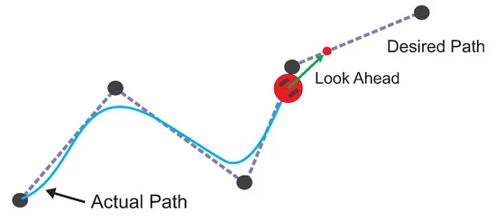
UGV Control
For UGV control Pure Pursuit Controller was used which is a path tracking algorithm.It computes the angular velocity command that moves the robot from its current position to reach some look-ahead point in front of the robot.

Slide 28
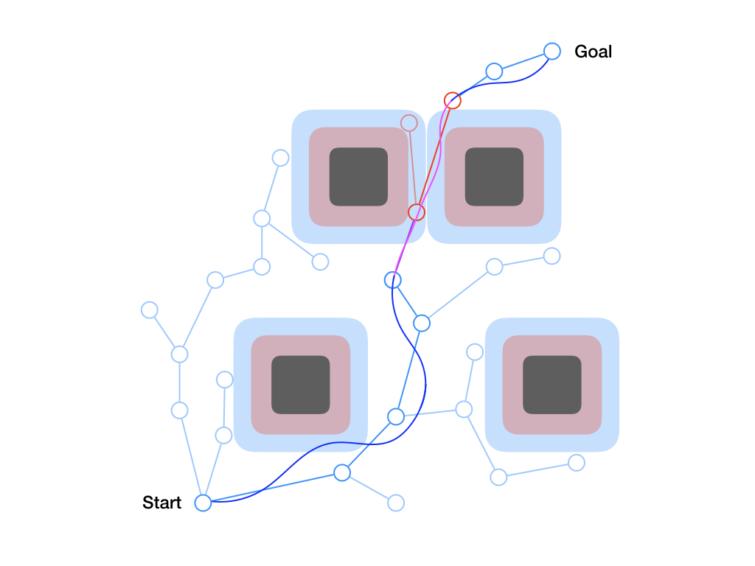
UGV Path Planning
Local Planner-OMPL(Open Motion Planning Library) which is a collection of state-of-the-art sampling-based motion planning algorithms.
Global Planner-TEB(Timed Elastic Band) is used which locally optimizes the robot's trajectory with respect to trajectory execution time, separation from obstacles and compliance with kinodynamic constraints at runtime.

Slide 29
Challenges Faced
Configuring the UAV IMU axis for accurately fusing the IMU data while localizing.
Height optimization while mapping the terrain autonomously as the depth data is lost at a height greater than 15 metres above the road.
Noise in the output image provided by the U-Net model along with the latency provided new challenges in the mapping phase.
Low camera update rate.
Insufficient hardware specs as we averaged around 0.1 RTF.
Scarcity of time for integrating the individual sub-parts.

Slide 30
Scope of Improvement
Road segmentation can be enhanced by much larger dataset and better camera sensor.
Mapping could be done autonomously by choosing frontiers on distance-based metric.
Reducing the inference time of the U-Net model and processing the filtered image before feeding it to RTabMap.
More accurate tracking of UGV using object tracking and optical flow methods.

Slide 31
Performance Analysis(Phase-I)
Computation | Cost(approx)
Gazebo | 2 cores
Ardupilot | 0.085 cores
RTabMap + UAV Localization | 0.3 cores
Road segmentation | 4 cores

Slide 32
Performance Analysis(Phase-II)
Computation | Cost(approx)
Gazebo | 2 cores
Ardupilot | 0.085 cores
UAV + UGV Localization | 2 cores
UGV Control | 0.5 cores

Slide 33
System Specifications
OS | Ubuntu 20.04
Processor | 11th Gen Intel(R) Core(TM) i5-1135G7 @ 2.40GHz
Graphics | GeForce MX350

Slide 34
Thank You

